Slide 1
Considerations for Adaptation
AKA - Where We’re Going, What We Need
Casey Sclar, Ph.D.
Plant Health Care Leader - Longwood Gardens Inc.
Interim Executive Director – American Public Gardens Association csclar@longwoodgardens.org
csclar@publicgardens.org

Slide 2
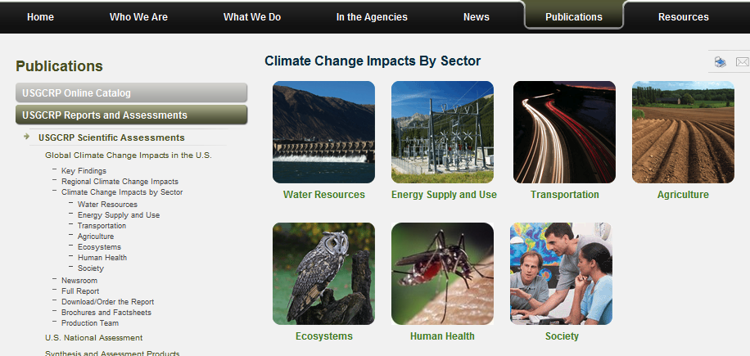
http://www.globalchange.gov/publications/reports/scientific-assessments/us-impacts/climate-change-impacts-by-sector
Public Gardens are cultural, conservation, economic, educational, recreational resources

Slide 3
What We Need…
“One Stop Shopping”
“Key Stories to Tell”
“Global, Yet Local”

Slide 4
What We Need…
“One Stop Shopping”
Web portal for plant sector
Consolidates diverse information
“Key Stories to Tell”
“Global, Yet Local”

Slide 5
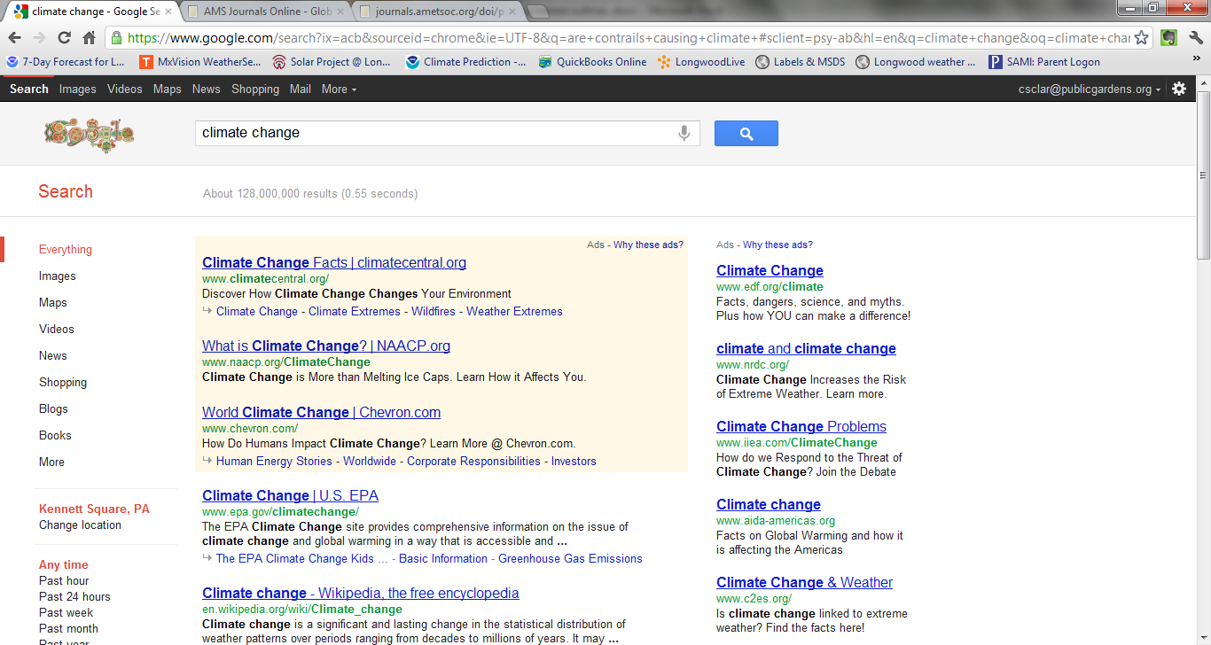
Why…?
Only government sector here = EPA

Slide 6
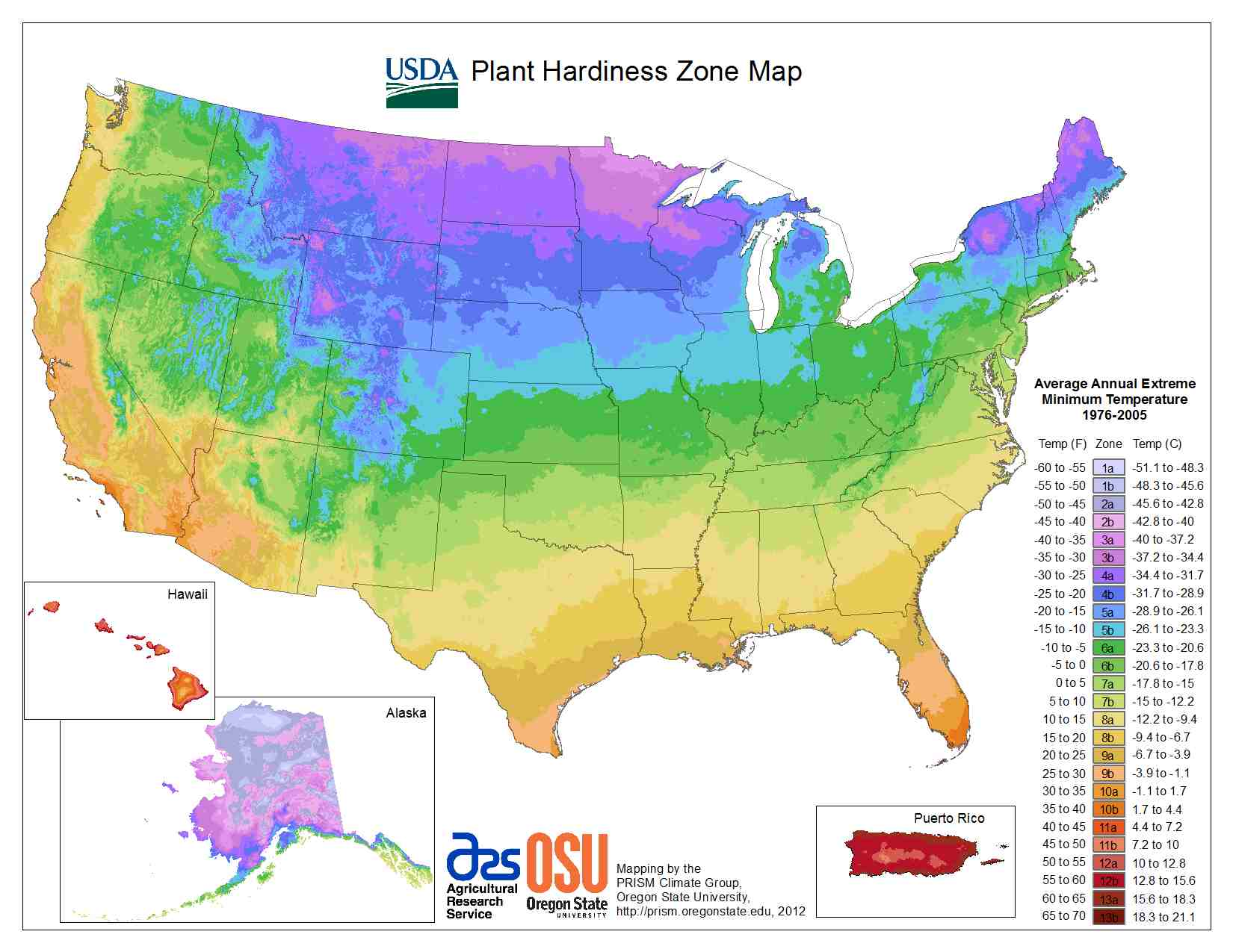
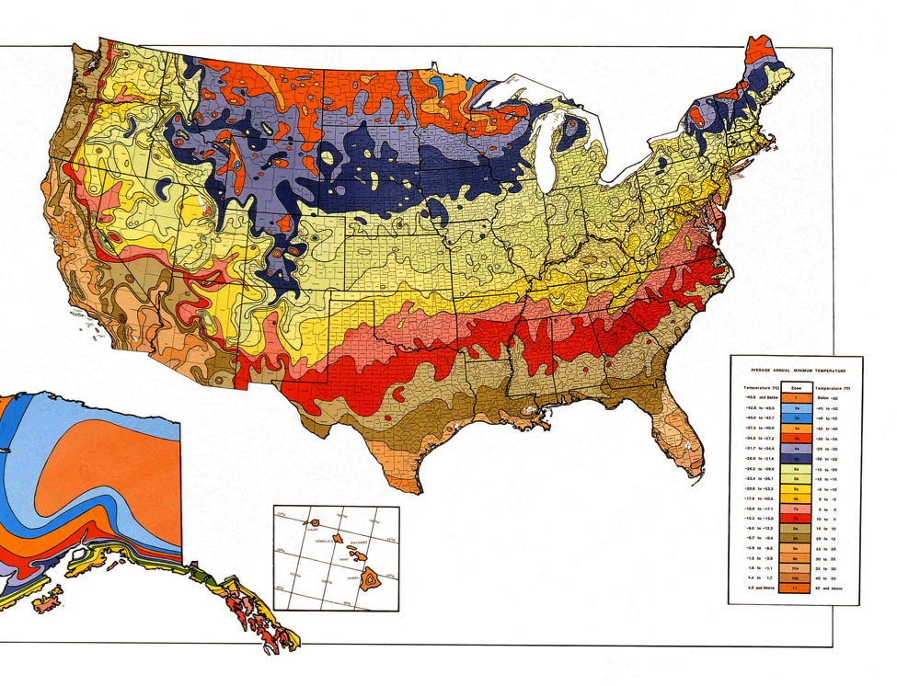

Slide 7
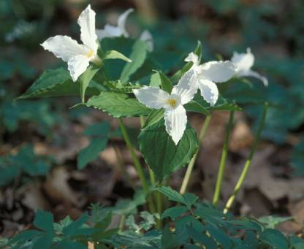
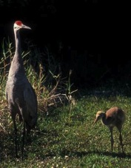
Climate change and phenology:
Phenological change as evidence of global warming.
Global warming and the distribution of species.
Changes in insect life cycles: physiological and evolutionary.
Phenological asynchrony and decoupling of species interactions.
Atmospheric CO₂, plant quality, and herbivores.
Phenology: The study of recurring biological events.
Adapted from D. Herms 2012

Slide 8
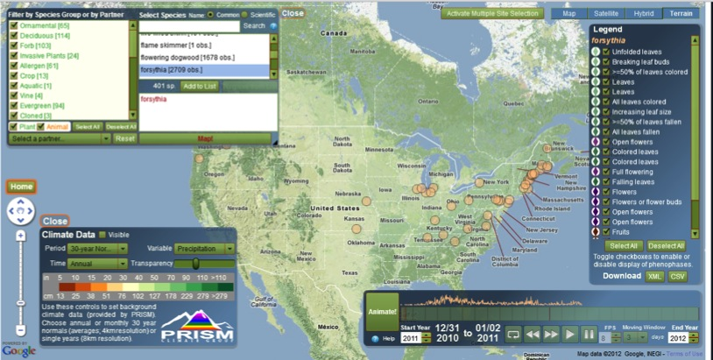
The USA National Phenology Network (USA-NPN) serves science and society by promoting broad understanding of plant and animal phenology and its relationship with environmental change. The Network is a consortium of individuals and organizations that collect, share, and use phenology data, models, and related information.

Slide 11
An analysis of 28 Greater Philadelphia species, native to Pennsylvania and Delaware Piedmont, and 2539 flowering records from 1840 to 2010 indicated that plants are responding to rising minimum monthly temperatures. On average, these species are flowering 16 days earlier over this 170 year period and 2.7 days earlier per °C rise in monthly minimum temperature.

Slide 12
The one-two month period prior to flowering has the greatest contribution to flowering time reduction
Observations in Panchen’s study can only be partially explained by rising temperatures, other factors may also be at play…

Slide 13
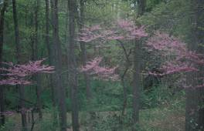
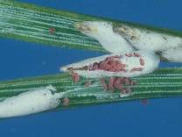
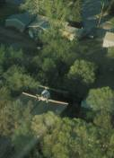
The flowering sequence of plants can be used as a biological calendar to track degree-days and schedule pest management appointments.
S. Gage, Michigan State Univ.
D.G. Nielsen, Ohio State Univ.

Slide 14
Phenological Sequence for Secrest Arboretum
Species Event Degree-Days
Red Maple first bloom 45
Eastern Tent Caterpillar egg hatch 92
Eastern Redbud first bloom 197
Gypsy Moth egg hatch 203
Snowdrift Crabapple first bloom 214
Birch Leafminer adult emergence 231
Common Lilac first bloom 238
Pine Needle Scale egg hatch 301
Vanhoutte Spirea first bloom 309
Lilac Borer adult emergence 336
Black Cherry first bloom 376
Euonymus Scale egg hatch 463
Black Locust first bloom 503
Bronze Birch Borer adult emergence 519
Mountain-laurel first bloom 565
Juniper Scale egg hatch 579
Littleleaf Linden first bloom 878
Japanese Beetle adult emergence 966

Slide 15
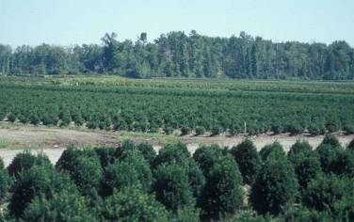
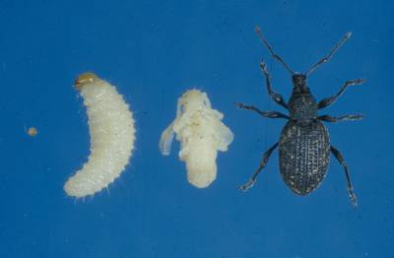
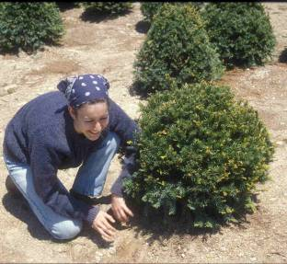
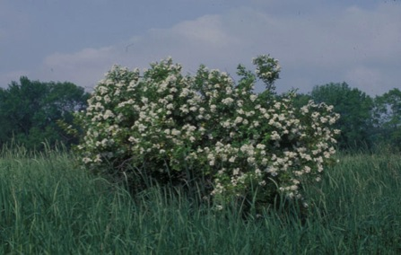
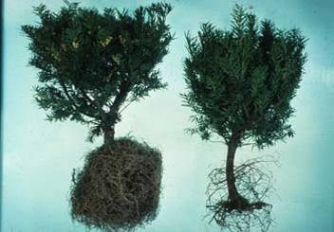
Black vine weevil now emerging 2-3 weeks earlier than in 1970
D.G. Nielsen, Ohio State University
D.G. Nielsen, Ohio State University
Gina Penny
Multiflora rose, Rosa multiflora

Slide 16
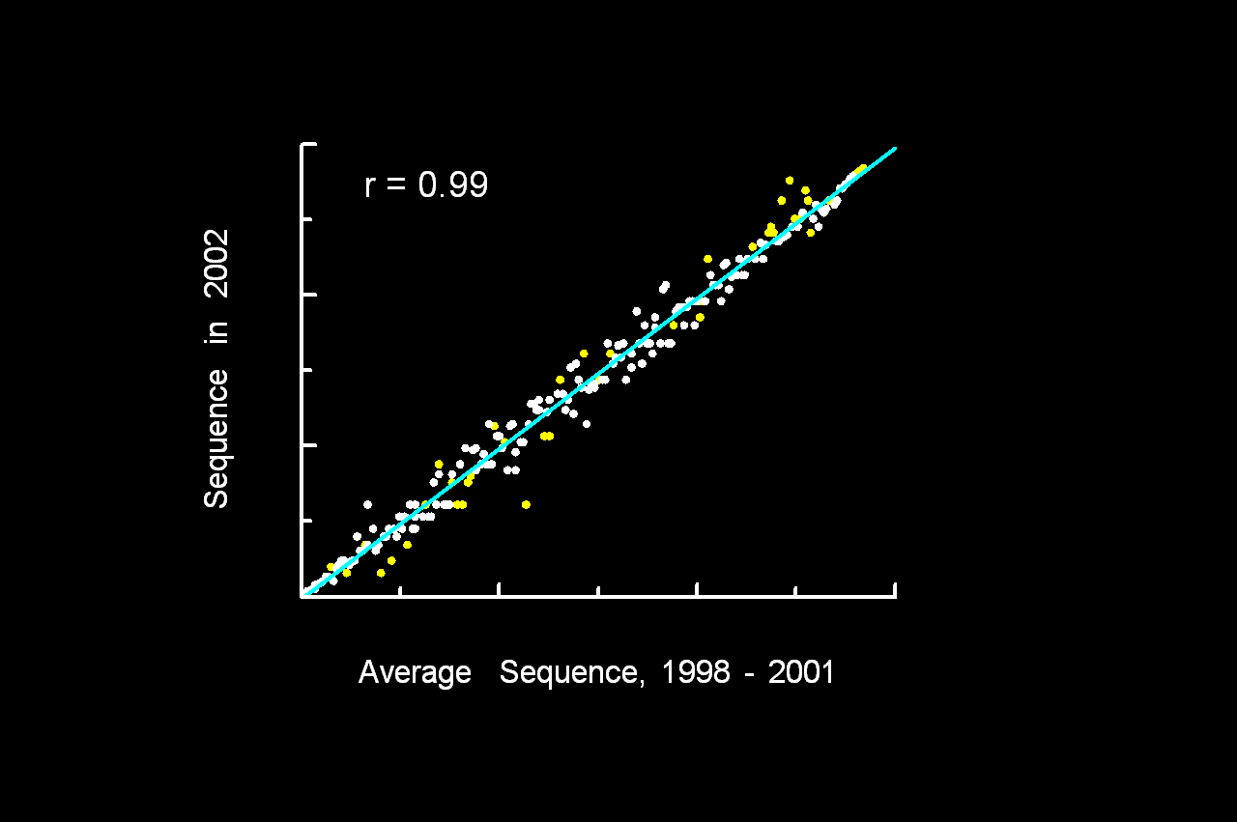
Key premise: phenological sequence remains constant from year-to-year.

Slide 17
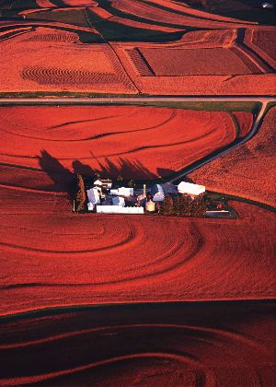
Implications of Climate Change for Agricultural Pest Management OARDC SEEDS Interdisciplinary Project
Robin A. J. Taylor John Cardina Department of Entomology Department of Horticulture & Crop Science Daniel A. Herms Richard H. Moore Department of Entomology Human and Community Resource Development

Slide 18
Synthesis: Diversity, Distribution, and
Abundance
Global warming and elevated CO2 can have
interacting effects on development rates, host
quality, and nutritional ecology to alter:
phenology and voltinism patterns
species distributions
population dynamics
ecological interactions
community composition
evolutionary trajectories

Slide 19
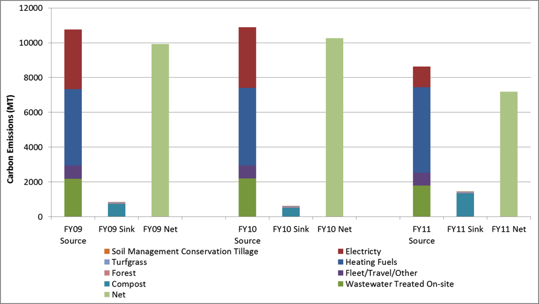
Longwood’s Ecofootprint: FY2009 –FY2011

Slide 20
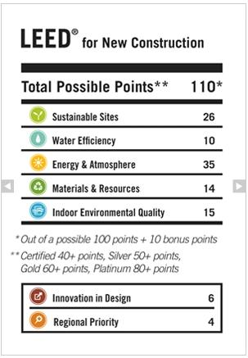
A Sustainability Index for Public Gardens
What is it?
A set of criteria and metrics to evaluate sustainability performance
Enables participants to measure and benchmark their own sustainability performance.
Facilitates marketing claims about sustainability performance backed by data.
Commonly includes tiered performance levels that reflect a range of acceptable practices and promote continual improvement.

Slide 21
Focus on the issues that matter most…
Life Cycle Stages
Life Cycle “Hot Spots” – the issues that contribute the greatest impact, or have the greatest potential for improvement
Sustainability Impact Category | Raw Mat’ls | Gardens & Grounds | Admin & Maintenance | Other Guest Experience
Air
Climate Change | Fuel production | Heating conservatories | Heating other buildings | Cooking, plate washing in restaurant
Water
Waste
Biodiversity
Community
High Priority
Medium Priority
Low Priority
Example only – not representative of all public gardens.
Notes:
High priority areas would be given a greater weighting in the Index than the low priority areas.
The Longwood Gardens eco-footprint focused on Scope 1 (i.e. direct) and Scope 2 (i.e. impacts from energy sources). Impacts from raw materials (i.e. Scope 3) were not included in the analysis.

Slide 22
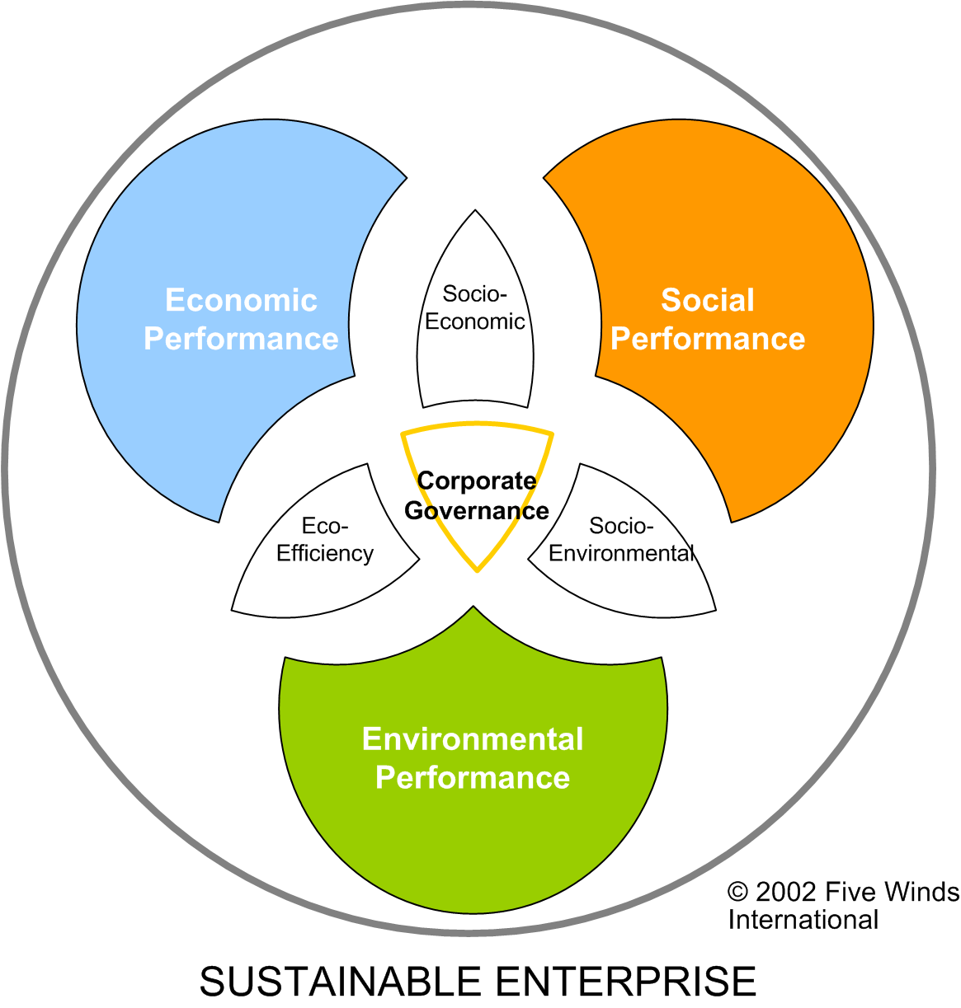
…to provide a platform for governance
The term “sustainability” is widely used and variably defined, but current convention generally defines sustainable business practices as having a “triple bottom line” to measure success based on three pillars:
people (social performance);
planet (environmental performance); and
financial viability (economic performance).
Public Garden Sustainability Index
Notes:
An accepted definition of sustainable development is “meeting the needs of today without compromising the needs of future generations.” Another common definition is the notion of the 3-legged stool: “achieving economic growth, environmental protection and social progress at the same time”.

Slide 23
What We Need…
“One Stop Shopping”
“Key Stories to Tell”
Must be a select few only
“You pick ‘em, we’ll tell them…”
“Global, Yet Local”

Slide 24
CLEO Project
Created by founder of Fairchild Challenge
Use the public to tell the story to the public
Active learning
“Pay Knowledge Regarding CC Forward”

Slide 25
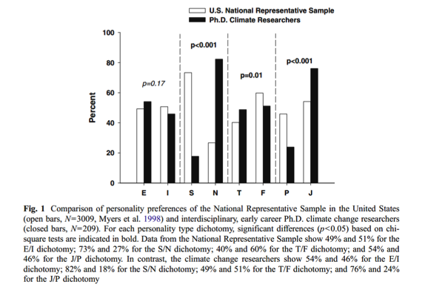
Our results demonstrate that the dominant personality types for Ph.D. climate change
researchers are fundamentally different from those found in the U.S. population. This
suggests that there is a strong potential for inherent challenges in communication between
these two groups. As the climate change community continues to move forward with
effective communication and education, it is important to keep in mind that it isn’t just
“what we say” but, “how we say it”.
Weiler, C., Keller, J. & C. Olex. 2011. Personality type differences between Ph.D. climate researchers and the general public: implications
for effective communication. Climatic Change. DOI 10.1007/s10584-011-0205-7. http://disccrs.org/files/WeilerEtAl_2011_ClimaticChange_MBTI.pdf

Slide 26
American Climate & Environmental Values Survey ecoAmerica, 2011
VALS methodology used:
http://strategicbusinessinsights.com/vals/
Notes:
ecoAmerica’s 2011 research builds upon the findings from 2008
VALS methodology used. Learn more, take online test: http://strategicbusinessinsights.com/vals/

Slide 27
ACEVS Summary Findings (2011)
Two types of environmental morality offer opportunity.
Climate solutions need to be more “masculine” to garner support.
We’re not ready to abandon the American Dream.
Significant support exists among “green” Americans for nuclear power.
Weather & climate connections are emerging, but unevenly.
Americans are calling for common sense.
Growing fatalism & economic woes impact green motivations and action.
Resentment and excuses about eco-climate issues are growing.
Conflicting loyalties, dissonance and confusion are strong factors.
Notes:
There are nine the top findings.
Three are most relevant to gardens.
A summary of all 9 are in the report.

Slide 28
1. Two Types of Morality Emerging
IMPLICATIONS
Altruistic morality lumps birds, nature, oceans in an “idealized bubble.” Appeals to correcting violations of nature and “the right thing to do” may work better than pragmatic concerns (e.g. jobs) among the more educated / wealthy.
Americans who live “closer to the economy” are more concerned about chemicals in nature, nuclear power and environmental disasters. Comparisons of disasters to people (e.g oil spills) can be effective calls to action.
FINDING
Two types of morality show promise for engaging Americans.
“Altruistic” morality appeals strongly to high-resource Americans – grounded in “the right thing to do.”
“Mirror” morality is emerging among physical (vs. knowledge) workers grounded in “fear” of harm or loss.
Notes:
Two types of morality are emerging in 2011.
The first is Altruistic morality, which appeals to, and drives the high resource Americans to support environmental and climate initiatives.
The second type is what we are calling “Mirror” morality. This morality appeals to the Americans who live close to the land and work with their hands. It motivates action on eco-climate issues because it stems from these folks seeing changes and disasters close-by, and making the connection that they could be personally affected.
These two types of morality are very different from each other. Altruistic morality is grounded in “the right thing to do”, mirror morality, in fear of harm or loss.
So what does this mean for us in our collective work?
For Altruistic morality, because these high resource Americans lump all our issues into an “idealized bubble”, we need to appeal to them to help us correct violations of nature because IT IS THE RIGHT THING TO DO. They get the pragmatic concerns, like jobs and saving money, but they are more emotionally motivated by, and therefore more likely to engage with us, if we focus on the altruistic morality of their participating in our solutions.
For the Americans who live closer to the economy and land, showing them how disasters have affected real people like them, in communities like theirs, can be effective in motivating their action. They are particularly concerned about the dangers of chemicals, nuclear, disasters, and are motivated to prevent or avoid them.

Slide 29
3. Not Ready to Abandon the American Dream
FINDING
Upwardly mobile, status-seeking Americans strongly reject messages of sacrifice or doing with “less”
These ‘keep up with the Jones” types represent the core of American consumers – advertiser targets
They work hard and seek better homes, cars, education and “things.”
They have “earned” the right not to be denied what others have
IMPLICATIONS
Messages like “The Story of Stuff” do not resonate with middle-class, knowledge workers seeking to get ahead
Don’t emphasize changes and new. They also are afraid of change and don’t want rules changed or goal posts moved.
Need extrinsic motivation: emphasize rewards for good and avoiding bad
They are followers. Need to show success and being part of the group
Notes:
Many Americans are taught from an early age that if they get a good education, a good job, work hard, and take care of their family, then they deserve to have a better car, a bigger house, and whatever material possession they can afford.
They do not respond to messages of sacrifice.
They ACTIVELY resist them, and are, in fact, resentful of these requests AND of us who are making them.
This group is 14% of the American population and it is important to note that many other groups of Americans look to them as the ”ideal”, taking cues from them on how to behave.
So what can we do with this finding?
We can first remove sacrifice from our messages and offerings to this group.
We can also refrain from talking about change as a solution. This group does not like change. In fact, they are working toward a strict set of rules called the American Dream, and they don’t want anyone moving their goalposts.
One way we CAN potentially use change is to show how climate will impact the lifestyle they have worked so hard to achieve. We need to be careful about this, however, because this group has a very shallow tolerance for negative information. Use the word FACTS, not science.
This group needs extrinsic motivation for taking action, so we need to provide them tangible rewards for participating in our solutions.
They take clues from their social groups and media for how to behave, so we need to make our solutions part of the “norm” in their lives. They are particularly influenced by peer pressure and don’t want to seem “weird” – They actually want to appear “smart”
So programs such as neighborhood solar, discounts for energy efficient appliances and gadgets, and seeing their favorite celebrities such as Martha Stewart or Rachel Ray practice green behaviors are promising directions.

Slide 30
6. A Call for Common Sense
FINDING
Americans quickly self-identify as “green” or not.
Those that are not ‘green’ see expensive gas; NIMBY wind and solar; sacrifice; and ‘endangered species’ arguments as irrational.
People who reject “green” consider “close to nature” a waste of time.
Common sense transcends ‘tribes’
IMPLICATIONS
Lack of common sense is perhaps the biggest de-motivator and excuse on eco-climate issues for most Americans.
We need to make eco-common sense real and a big part of our message.
Uncompromising, purist eco-climate positions especially with huge trade offs will lose both battles and the war.
Just repeating ‘science’ or normal green arguments with different messengers will not work with them
Notes:
As a movement we have done a really great job identifying what it means to be “green”.
Americans are now quickly self-identifying as “green” or not.
Those Americans who are not “green” think we have no common sense. They see us advocating for wind power, but “not in our own backyard”. They see us advocating for sacrifice while flying around in personal jets. And, they see us advocating for $5 per gallon gas while they are struggling to keep their jobs, put food on the table, and save their houses from foreclosure.
The powerful thing about us incorporating common sense into our movement is that common sense transcends tribal values. When presented with common sense approaches and solutions, Americans will engage. Why wouldn’t they? If it makes common sense, then the answer is obvious.
We then need to make common sense a core component of our identity, our programs, our SOLUTIONS, and our message.
This also means we need to refrain from uncompromising and argumentative positions on climate and the environment, from arguing in public and with each other, acting in an elitist manner, or just repeating the “science” or our traditional green arguments.

Slide 31
What We Need…
“One Stop Shopping”
“Key Stories to Tell”
“Global, Yet Local”
Need to provide regional coverage
Tie into larger picture

Slide 32
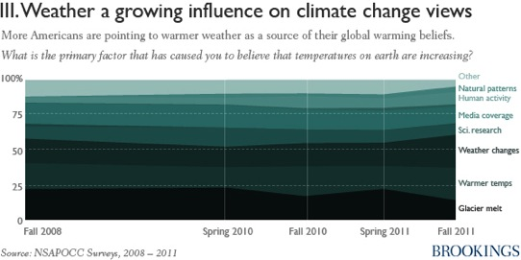
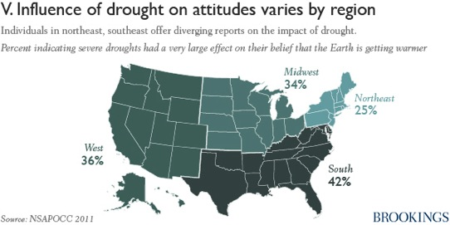
While compiled and forecast weather data needs to be available to promote the mental links between it and climate Climate change is a regional phenomenon with global implications.
It is best thought of as a “global, yet local” issue. Products should make local connections to global environmental factors

Slide 33
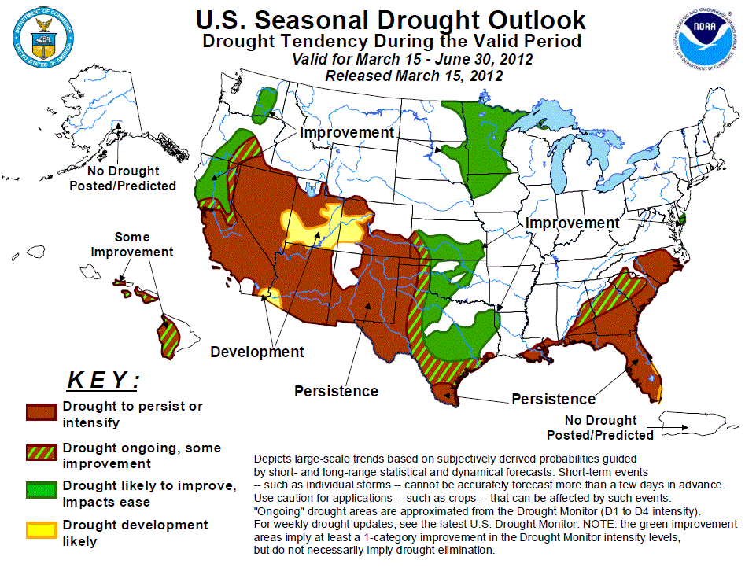

Slide 34
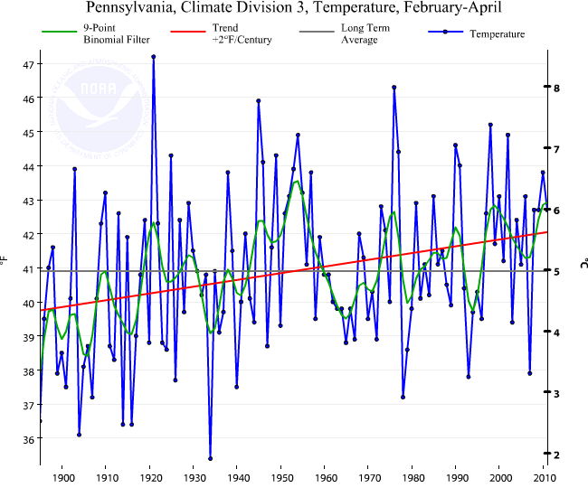
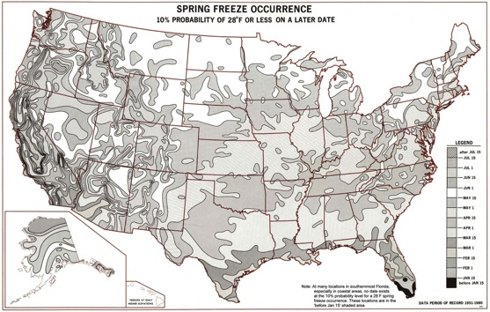
Products need to be regional adapted in nature. Must address common questions of Gardens Staff and Visitors
When to plant/put out frost tender species?
How much longer is the “new” growing season”?

Slide 35
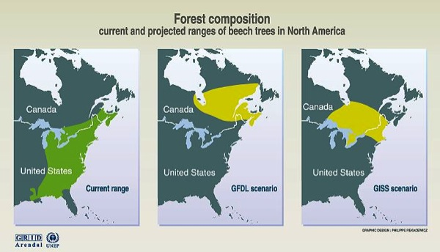
Plant Community Effects
The temperate deciduous forest shifts to more northern locations and is replaced by either the southeast mixed forest or savannas under scenarios except for the mildest one.
Bachelet et al. 2011
EPA
Slide Adapted from B. Byers - 2011

Slide 36
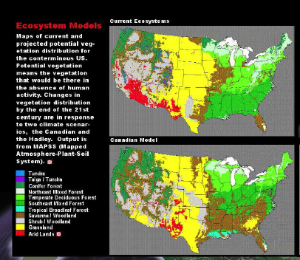
Plant Community Effects
Southeast mixed forest are replaced mostly by savannas under three scenarios: the UKMO scenario and CGCM1, which project the largest increases in temperature (both above 5°C), and the GFDL scenario. Southeast mixed forest are even replaced partially by grasslands under the two warmer scenarios.
Bachelet et al. 2011
Slide Adapted from B. Byers - 2011

Slide 37
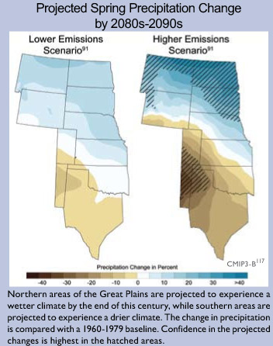
Plant Community Effects
… Both models simulate decreases in biomass or LAI (leaf area index) in the Great Plains states (Colorado, New Mexico, Texas, Oklahoma, Kansas).
Bachelet et al. 2011
Slide Adapted from B. Byers - 2011

Slide 38
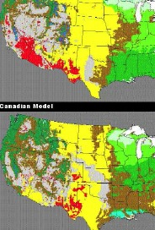
Plant Community Effects
… Models also agree on the contraction of the Southwest arid land area associated with large increases in biomass in several southwestern states (California, Nevada, and Arizona), due to the predicted increases in precipitation (and CO2-induced water-use efficiency) accompanying the rise in temperature.
Bachelet et al. 2011
Slide Adapted from B. Byers - 2011

Slide 39
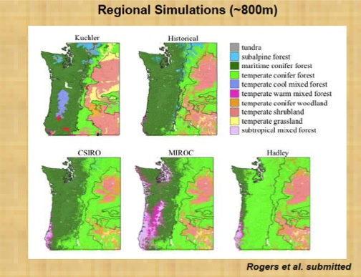
Plant Community Effects
Closer To Home
Western coniferous forests under warmer climates is less clear. (Vegetation model projects) large expansion of the coniferous forests across the western states, even though it simulates a decrease in C (carbon) density over the area of their current distribution.
Bachelet et al. 2011
Slide Adapted from B. Byers - 2011

Slide 40
Climate Model Predictions

Slide 41
Landscape Trees
Trees we are planting now will face a dramatically changed climate within their lifetime
Advance planting of southern trees?
Select for adaptability
Tree breeding, selection, and introduction
Cooperative evaluation

Slide 42
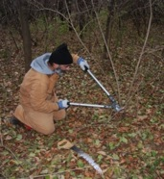
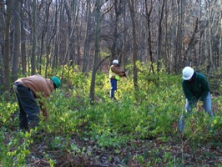
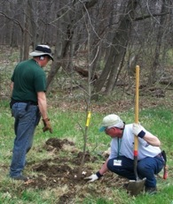
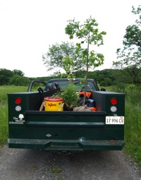
Management & Conservation Issues
Restoration vs. prospective management
Ecological functions over composition
Nativity
Genetic seed sources
Assisted migration
“Gardening in the wild”
Philosophical, ethical, and scientific issues
Managing long-lived trees for an uncertain future

Slide 43
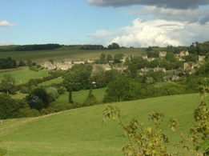
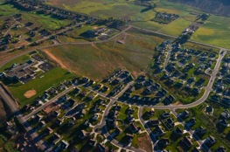
Modern Tree Migration Even Slower
Human development and landscape fragmentation
Outlier populations extirpated
Migration barrier speed bumps may slow trees to 10 km/century
Trees likely to move too slowly to keep pace with climate change

Slide 44
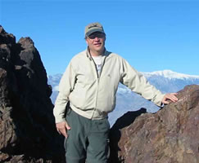
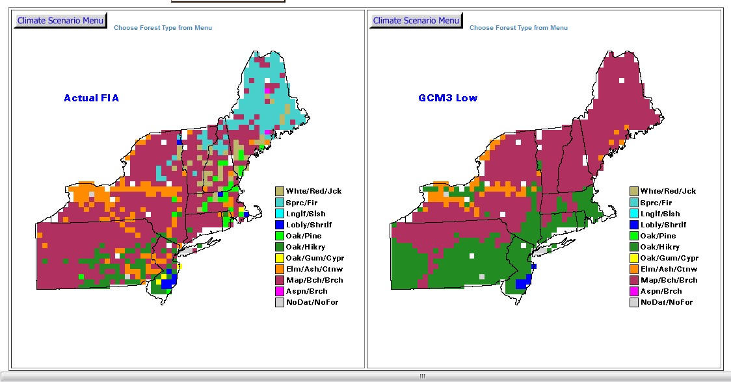
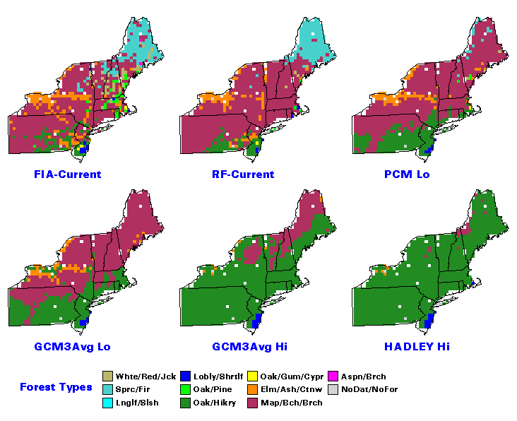
Long-Term Modeling
Louis Iverson - USFS
Prasad, A. M., L. R. Iverson., S. Matthews., M. Peters. 2007-ongoing. A Climate Change Atlas for 134 Forest Tree Species of the Eastern United States [database]. http://www.nrs.fs.fed.us/atlas/tree, Northern Research Station, USDA Forest Service, Delaware, Ohio.

Slide 45
Long-Term Modeling
Use data to drive plant community decisions during reforestation
Not just a “warming” trend, what about precipitation, upland adaptation to extremes?

Slide 46
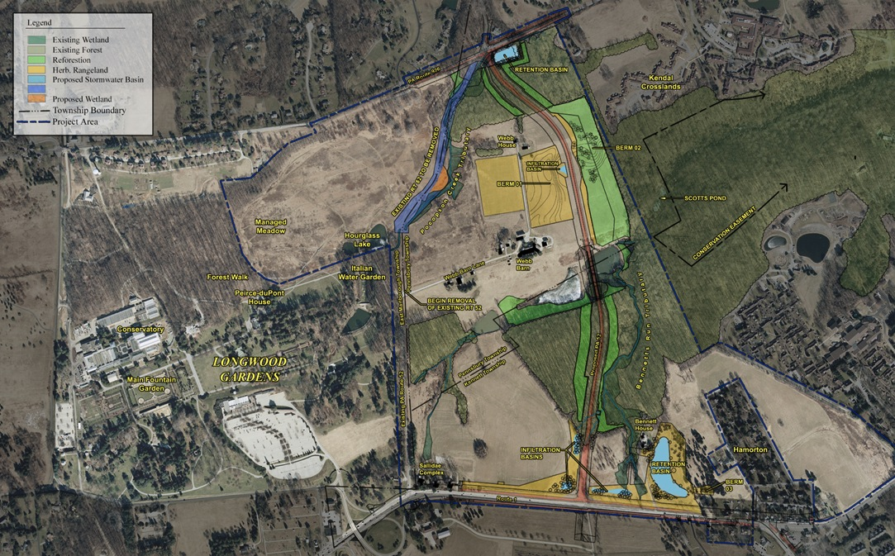
Reforestation – Spring & Fall 2012
3
1
4
2

Slide 47
Reforestation Trees and Shrubs To Be Determined By:
Current Forest Community Composition
Soil Texture and Chemistry
Light Exposure
Climate Change
Woodland Plug Mixes installed in existing canopy gaps
and/or site conditions above

Slide 48
Casey Sclar, Ph.D.
Plant Health Care Leader - Longwood Gardens Inc.
Interim Executive Director – American Public Gardens Association csclar@longwoodgardens.org
csclar@publicgardens.org

