Slide 1
Sectoral Engagement Activities at Noaa’s National Climatic Data Center
Tamara G. Houston
NOAA’s National Climatic Data Center
Asheville, NC

Slide 2
What is Sectoral Engagement?
NCDC recently developed a sectoral program in order to ensure that the climate information needs of climate sensitive socioeconomic sectors are understood, addressed, and provided.
The main goal of these renewed efforts is to not only respond to user needs but to anticipate user needs.
Sectoral engagement activities are a center-wide endeavor to better serve the user community.

Slide 3
Sectoral Teams
Agriculture
Civil Infrastructure
Coastal Hazards
Energy
Health
Insurance
Litigation
Marine and Coastal Ecosystems
National Security
Tourism
Transportation
Water Resources

Slide 4
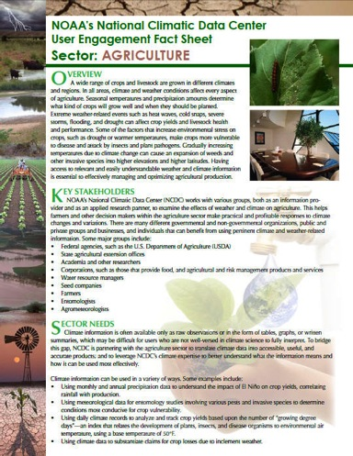
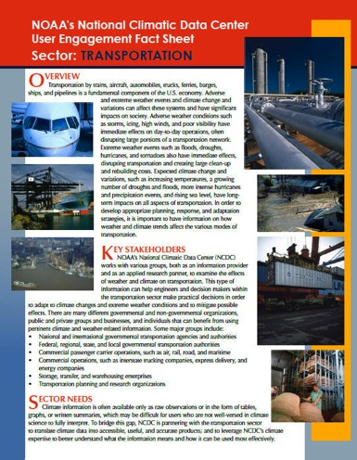
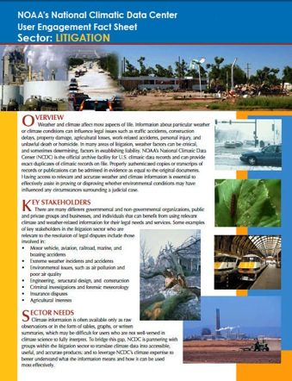
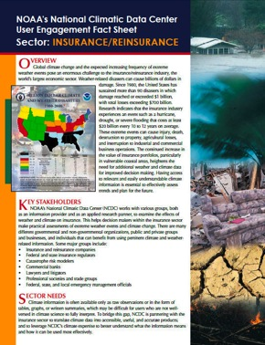
Sectoral Fact Sheets

Slide 5
Conferences & Workshops
During FY11, NCDC sponsored or co-sponsored 6 user workshops and attended and/or participated in over 60 sectoral workshops and conferences.
Involvement included organizing workshops, giving presentations, serving as a session chair or moderator, serving on sectoral committees, and … listening.

Slide 6
Major Milestones
Strengthened sectoral collaboration within NOAA agencies.
Increased collaboration with climate partners. (SCs, RCCs, RCSDs, RISAs, Sea Grants, etc.)
MOU with DOE, Western Governors Association, and CDC. LOI with APGA.
Increased access to sectoral datasets.

Slide 7
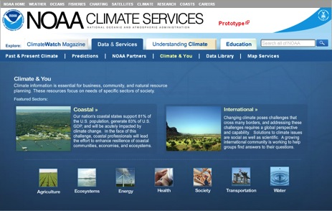
Success Stories
Partnerships
National Assessments
Climate.Gov

Slide 8
Success Stories
Agriculture
USDA Risk Management Agency
APGA
Civil Infrastructure
ASHRAE
Energy
1981-2010 Climate Normals
Health
NOAA/CDC Collaboration
Marine and Coastal Ecosystems
Interagency Collaboration
Water Resources
Drought Monitor
FEMA

Slide 9
For More Information
NCDC’s User Engagement Website:
http://www.ncdc.noaa.gov/oa/userengagement/
userengagement.html
Contact me at: Tamara.Houston@noaa.gov

